Slide 1




Course name: EES
B.TECH FIRST YEAR
ACADemic YEAR: 2020-2021
Course code : EE 1002
lecture series no : 01 (one)
Credits : 4
Mode of delivery : online (Power point presentation)
Faculty :
Email-id :
PROPOSED DATE OF DELIVERY:

Slide 2

Session outcome
“Recall concept of Semiconductors”

Slide 3
Assessment criteria’S
Assignment
quiz
mid term examination –I
mid term examination –II
END TERM EXAMINATION

Slide 4

PROGRAM OUTCOMES MAPPING WITH CO1 [[EC1001.1]. Apply principles of physics to describe the working of semiconductor devices. ]
[PO1]
Engineering knowledge: Demonstrate and apply knowledge of Mathematics, Science, and Engineering to classical and recent problems of electronic design & communication system.

Slide 5
Introduction to Semiconductors

Slide 6
Objective of the lecture: Define a semiconductor – no. of electrons in outer shell, location on periodic table, most commonly used ones etc.

Slide 7
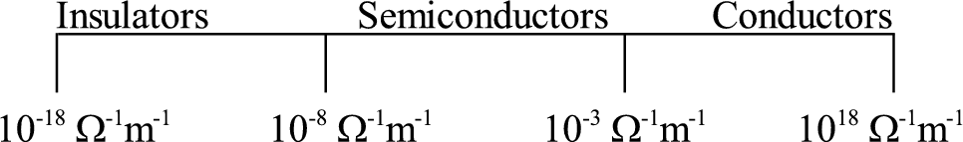
Introduction
Semiconductors are materials whose electrical properties lie between Conductors and Insulators.
Ex : Silicon and Germanium
Give the examples of Conductors and Insulators!
Difference in conductivity

Slide 8
Semiconductor Materials: Ge, Si, and GaAs
Semiconductors are a special class of elements having a conductivity between that of a good conductor and that of an insulator.
They fall into two classes : single crystal and compound
Single crystal : Germanium (Ge) and silicon (Si).
Compound : gallium arsenide (GaAs),
cadmium sulfide (CdS), gallium nitride (GaN),
gallium arsenide phosphide (GaAsP)
The three semiconductors used most frequently in the construction of electronic devices are Ge, Si, and GaAs.

Slide 9
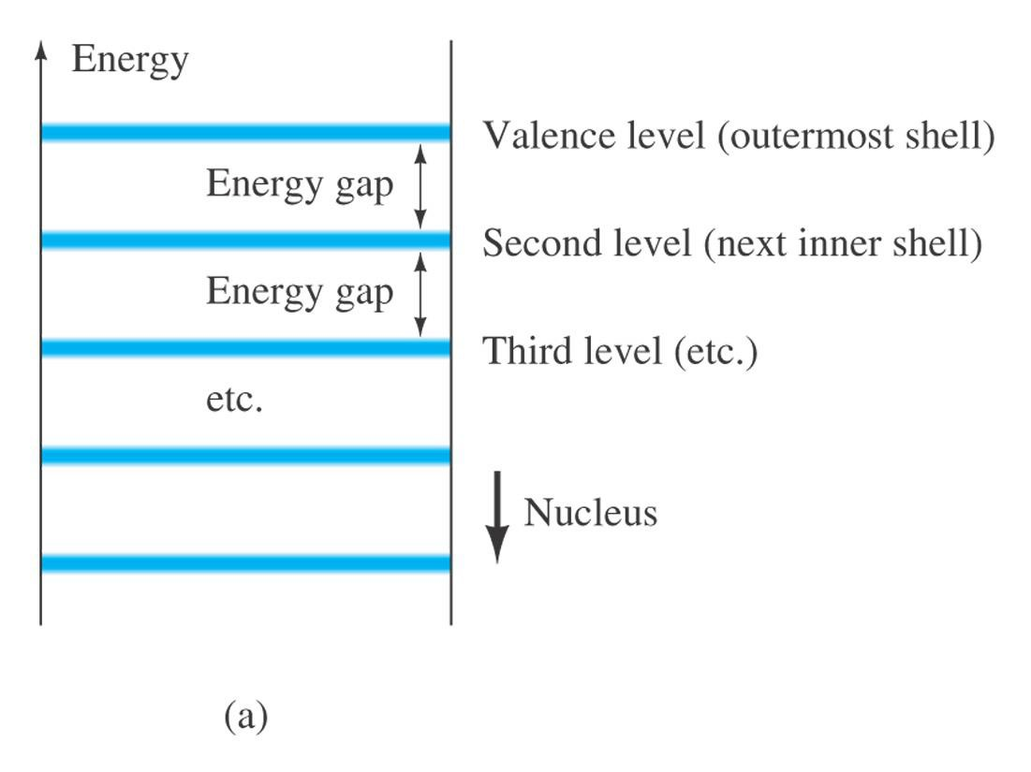
Energy Levels
The farther an electron is from the nucleus, the higher is the
energy state.

Slide 10
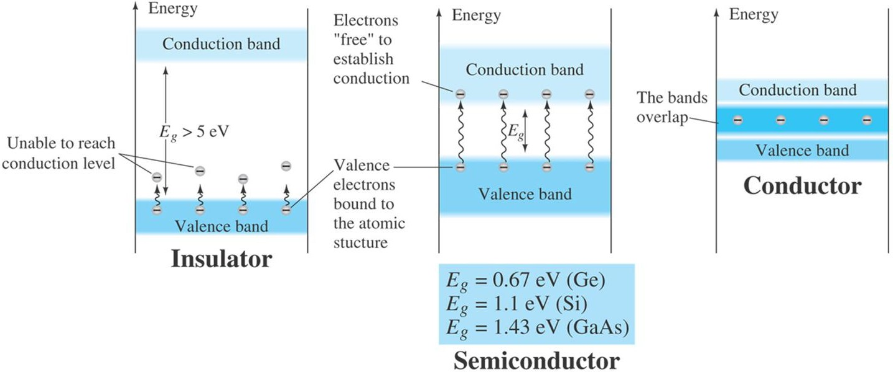
Energy Levels
An electron in the valence band of silicon must absorb more energy than one in the valence band of germanium to become a free carrier. [free carriers are free electrons due only to external causes such as applied electric fields established by voltage sources or potential difference.

Slide 11
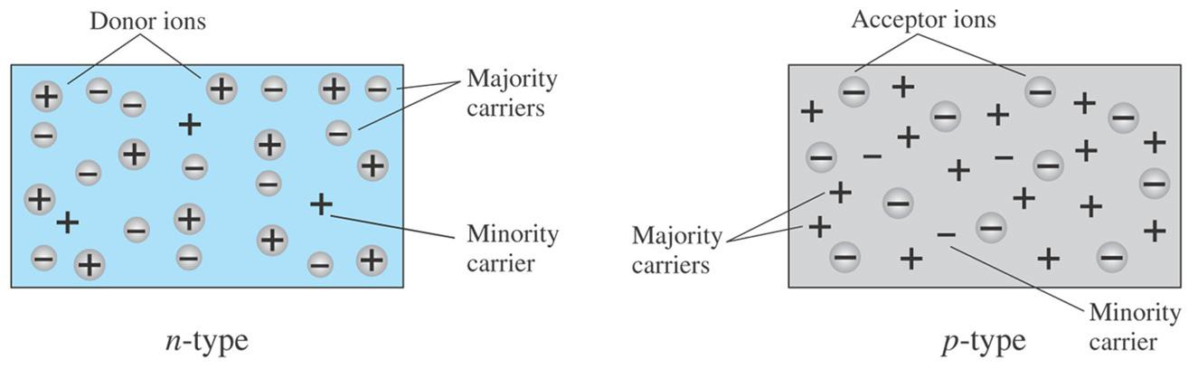
Majority and Minority carriers
Two currents through a diode:
Majority Carriers
The majority carriers in n-type materials are electrons.
The majority carriers in p-type materials are holes.
Minority Carriers
The minority carriers in n-type materials are holes.
The minority carriers in p-type materials are electrons.

Slide 12
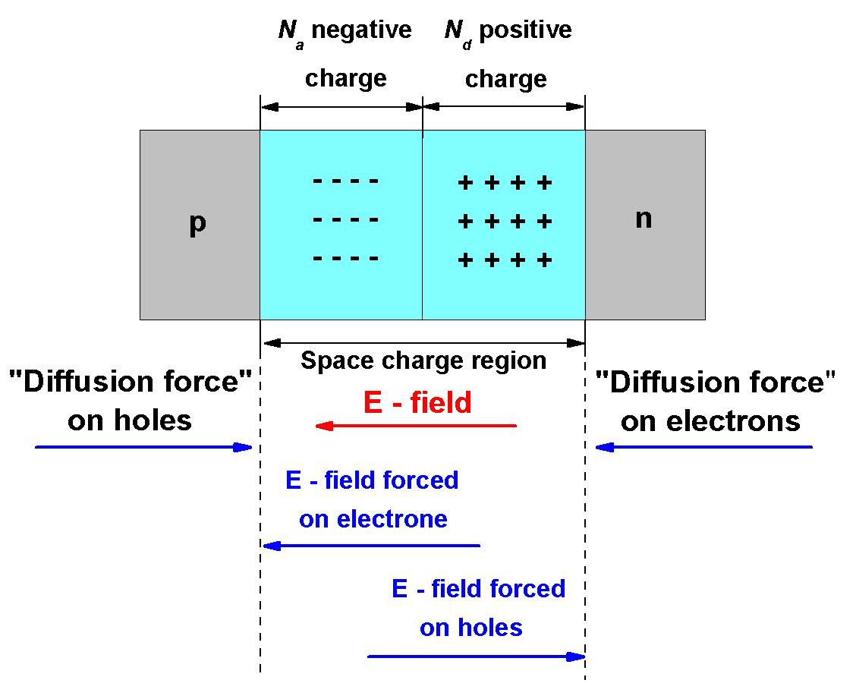
pn Junction
This cannot occur in the case of the charged particles in a p-n junction because of the development of space charge and the electric field (ε)
As electrons diffuse from the n region, positively charged donor atoms are left behind. Similarly, as holes diffuse from the p region, they uncover negatively charged acceptor atoms. These are minority carriers.
The net positive and negative charges in the n and p regions induce an electric field in the region near the junction, in the direction from the positive to the negative charge, or from the n to the p region.
The net positively and negatively charged regions
are shown in Figure. These two regions are referred to as the space charge region (SCR). Essentially all electrons and holes are swept out of the space charge region by the electric field. Since the space charge region is depleted of any mobile charge, this region is also referred to as the depletion region
Density gradients still exist in the majority carrier concentrations at each edge of the space charge region. This produce a "diffusion force" that acts the electrons and holes at the edges of the space charge region. The electric field in the SCR produces another force on the electrons and holes which is in the opposite direction to the diffusion force for each type of particle. In thermal equilibrium, the diffusion force and the E-field (ε) force exactly balance each other.

Slide 13
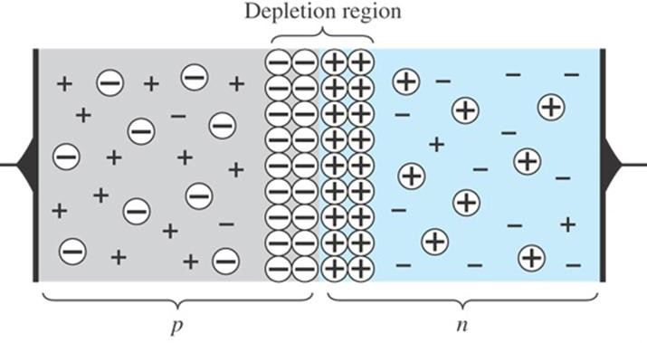


p-n Junctions
At the p-n junction, the excess conduction-band electrons on the n-type side are attracted to the valence-band holes on the p-type side.
The electrons in the n-type
material migrate across the junction to the
The result is the formation of a depletion region around the junction.
p-type
material
(electron flow).
Anode | P | N | Cathode
The electron migration results in a negative charge on the p-type side of the junction and a positive charge on the n-type side of the junction.

Slide 14


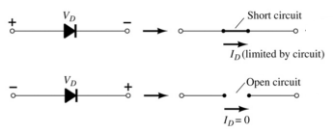

Diodes
The diode is a 2-terminal device.
A diode ideally conducts in only one direction.

Slide 15
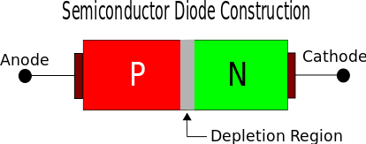
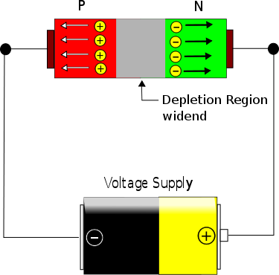
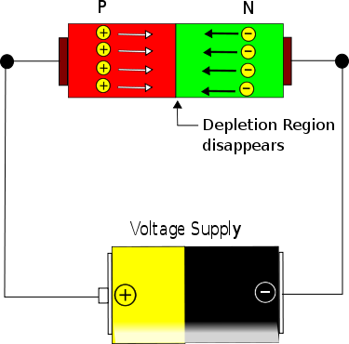
Diode Operating Conditions
No bias
Forward bias
Reverse bias
Reverse bias
Forward bias

Slide 16
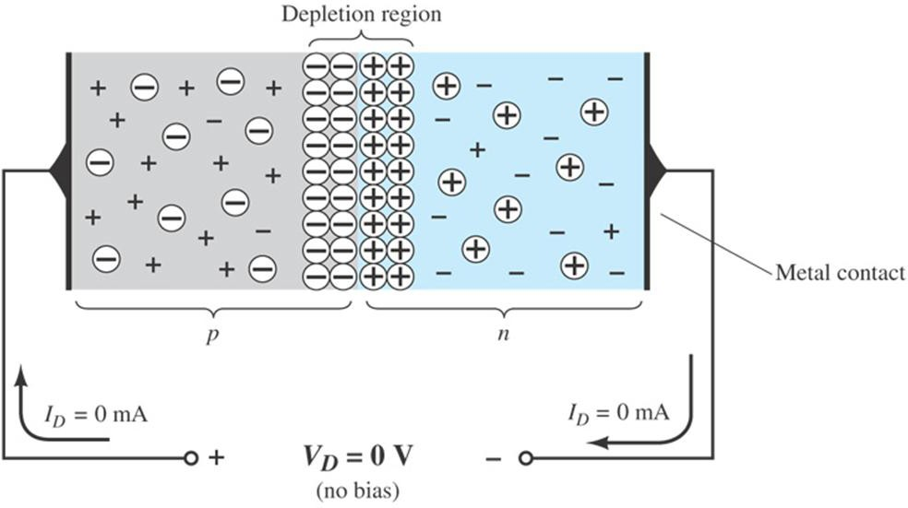

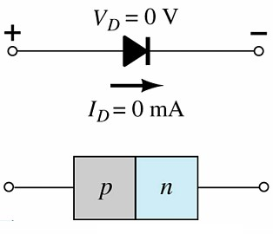

Diode Operating Conditions
No Bias
No external voltage is applied: V_{D} = 0 V
No current is flowing: I_{D} = 0 A
Only a modest depletion region exists

Slide 17
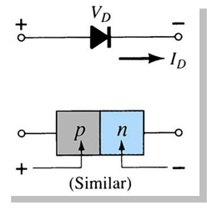
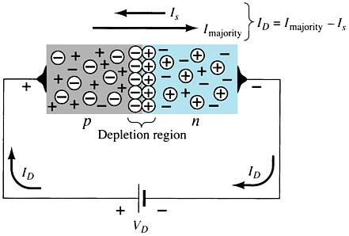

Diode Operating Conditions
Forward Bias
External voltage is applied across the p-n junction in the same polarity as the p- and n-type materials.
The forward voltage causes the depletion region to narrow.
The electrons and holes are pushed toward the p-n junction.
The electrons and holes have sufficient energy to cross the p-n junction.

Slide 18
Forward Bias Voltage
The point at which the diode changes from no-bias condition to forward-bias condition occurs when the electrons and holes are given sufficient energy to cross the p-n junction. This energy comes from the external voltage applied across the diode.
The forward bias voltage required for a:
gallium arsenide diode ≅ 1.2 V
silicon diode ≅ 0.7 V
germanium diode ≅ 0.3 V

Slide 19
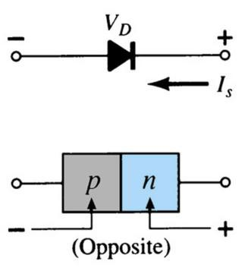


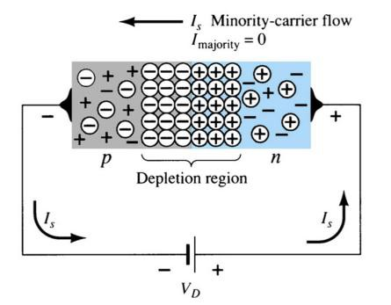

Diode Operating Conditions
Reverse Bias
External voltage is applied across the p-n junction in the opposite polarity of the p- and n-type materials.
The reverse voltage causes the depletion region to widen.
The electrons in the n-type material are attracted toward the positive terminal of the voltage source.
The holes in the p-type material are attracted toward the negative terminal of the voltage source.

Slide 20
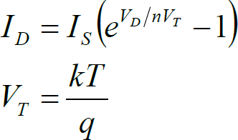
Diode equation
Where
V_{T} : is called the thermal voltage.
I_{s} : is the reverse saturation current.
V_{D} :
is the applied forward-bias voltage across the diode.
n : is a factor function of operation conditions and physical
construction. It has range between 1 and 2. assume n=1 unless otherwise noted.
K : is Boltzman’s constant =1.38 x 10⁻²³
T: is temperature in kelvins = 273+temperature in C.
q : is the magnitude of electron charge = 1.6 x 10⁻¹⁹ C.

Slide 21
Diode characteristics
I (mA)
Diode symbol
P
N
Reverse saturation current (magnified)
V_{γ} 1
V (volts)
Vγ is 0.2 ~ 0.3 for Ge
0.6 ~ 0.7 for Si
Cut-in or knee voltage
Breakdown
(μA)

Slide 22
Temperature dependence of diode characteristics
Reverse saturation current approximately doubles for every 10 degree rise in temperature
I_{o2} = I_{o1}2
(T −T ) /10
2 1
Where, I_{o1} is reverse sat current at temperature T₁ and
I₀₂ is reverse sat current at temperature T₂
Cut-in voltage decreases with increase in temperature

Slide 23
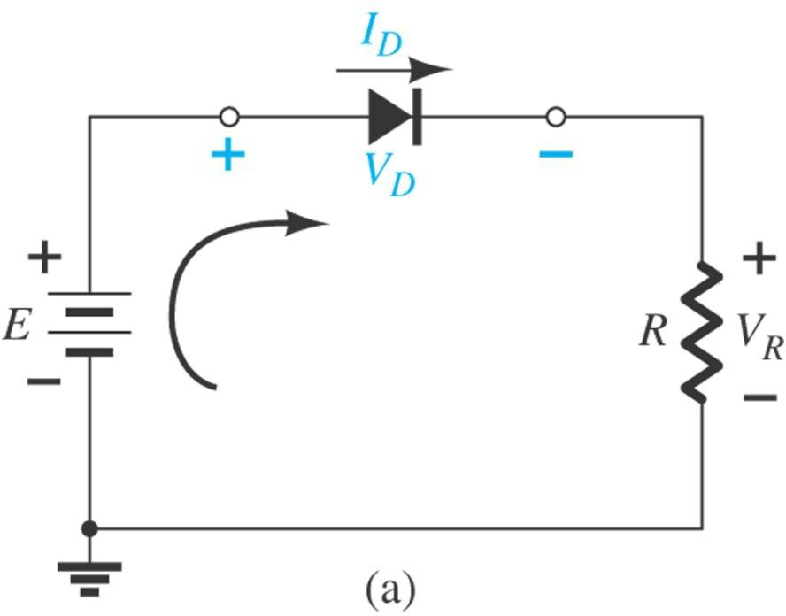
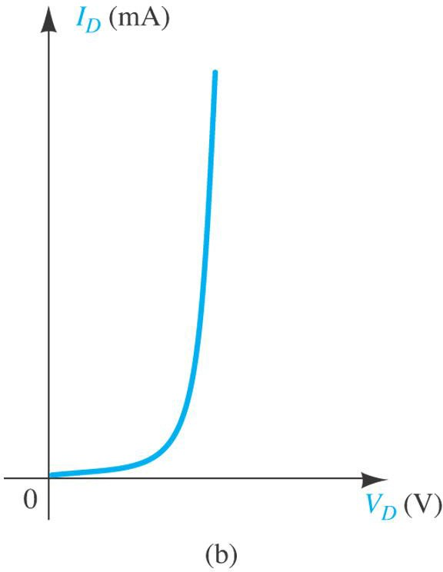
Load-Line Analysis
The analysis of diode can follow one of two paths: using the actual characteristics or applying an approximate model for the device.
Load Line Analysis: is used to analyse diode circuit using its actual characteristics.

Slide 24
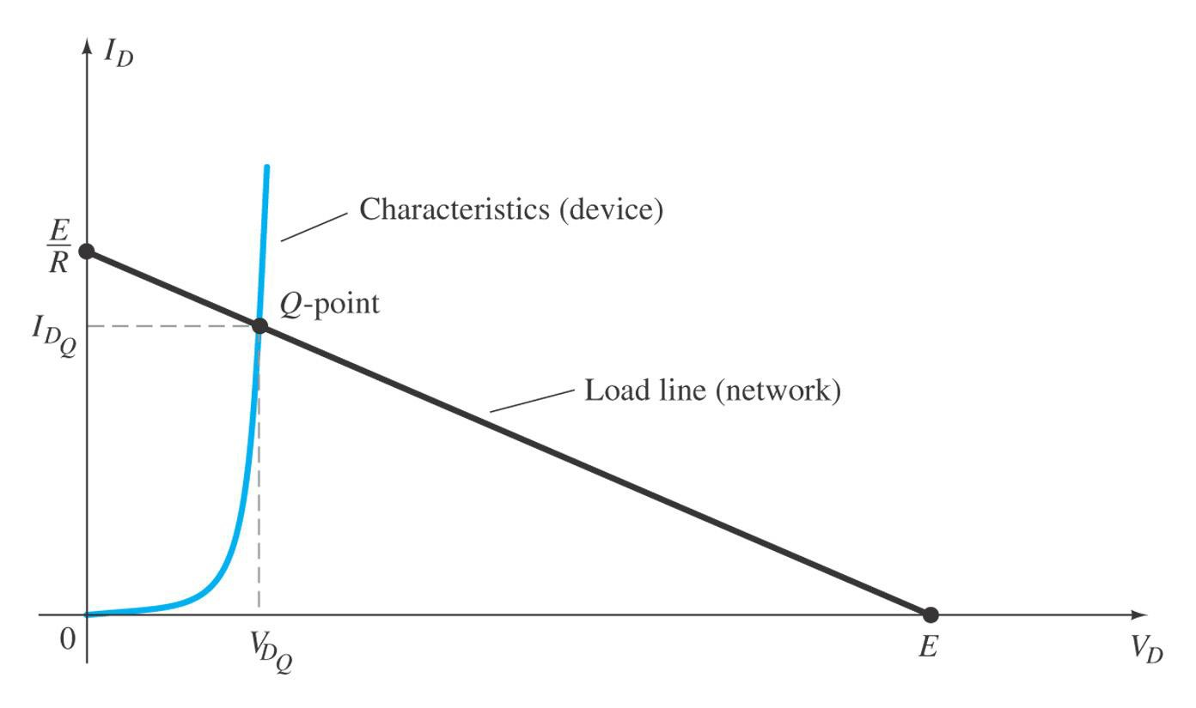
Load-Line Analysis
A straight line is defined by the parameters of the network.
It is called the load line because the intersection on the vertical axes is defined by the applied load R.

Slide 25
Load-Line Analysis
The maximum I_{D} equals E/R, and the maximum V_{D} equals E.
The point where the load line and the characteristic curve intersect is the Q-point, which identifies I_{D} and V_{D} for a particular diode in a given circuit.

Slide 26
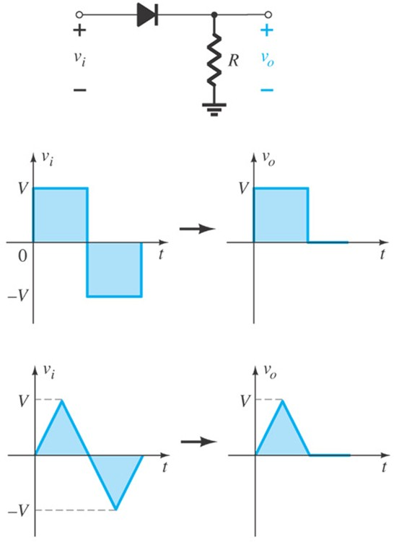
Diode Clippers
Clippers are networks that employ diodes to “clip” away a portion of an input signal without distorting the remaining part of the applied waveform.

Slide 27
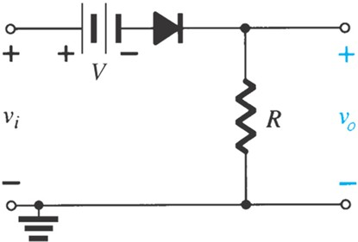
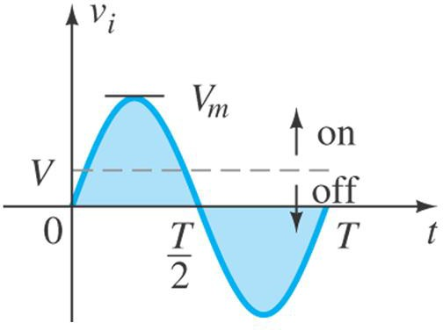
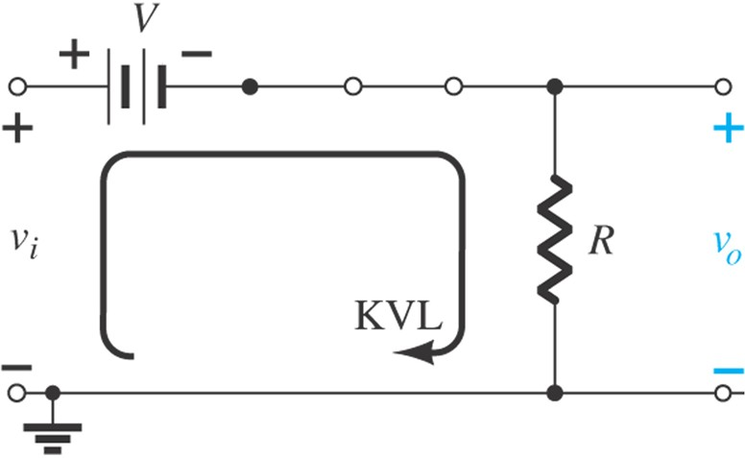
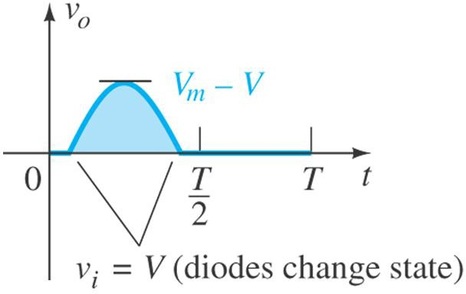
Diode Clippers
Determining v_{o} for the diode in the “on” state.

Slide 28
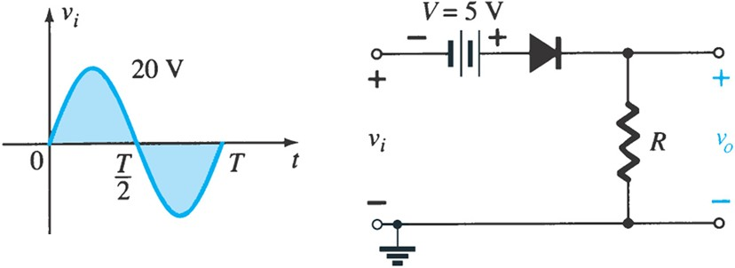
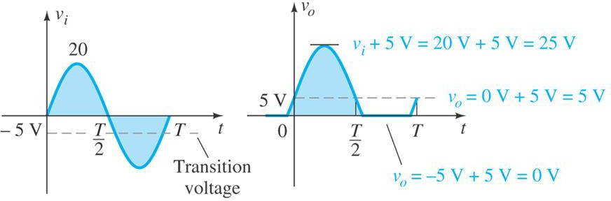
Example:
Determine the output waveform for the network.
Solution

Slide 29
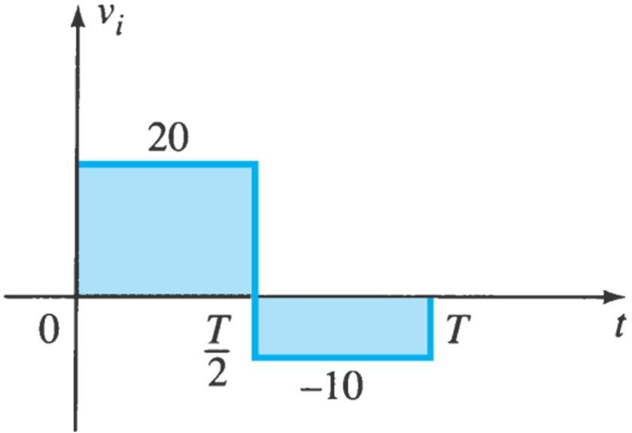
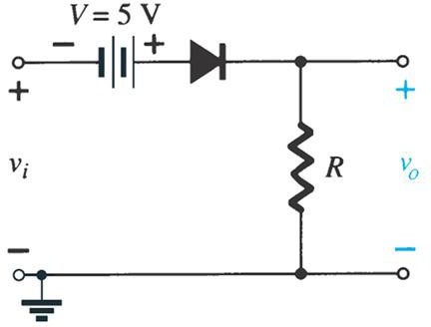
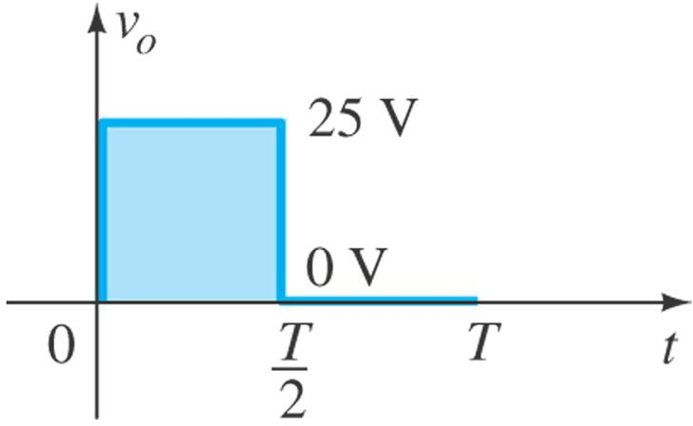
Example:
Determine the output waveform for the network.
Solution

Slide 30
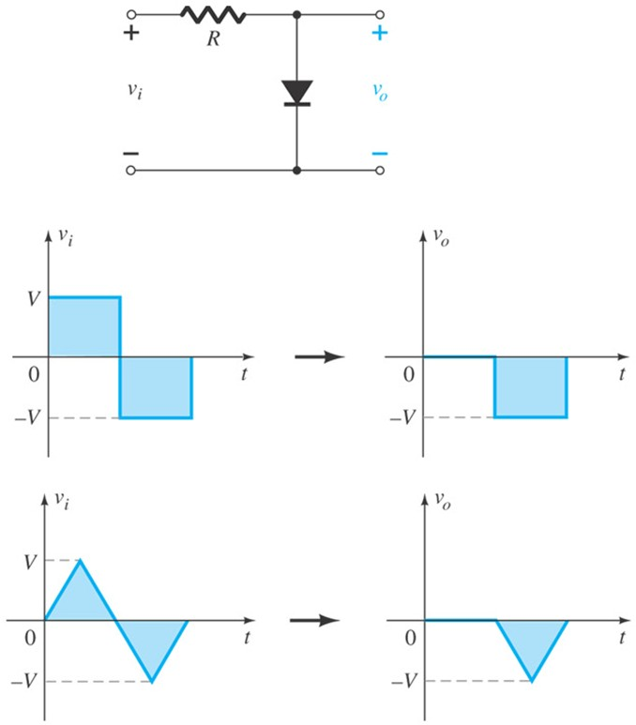
Parallel Clippers
The diode in a parallel clipper circuit “clips” any voltage that forward bias it.
DC biasing can be added in series with the diode to change the clipping level.

Slide 31
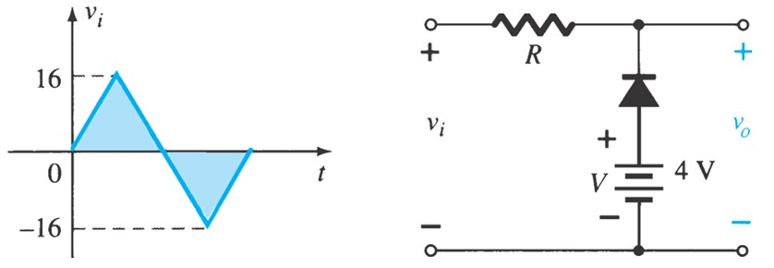
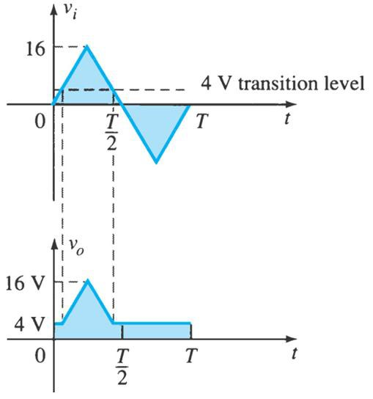

Example:
Determine v_{o} for the network shown.
Solution

Slide 32
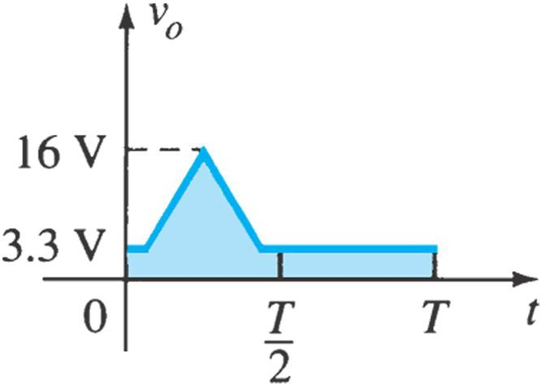
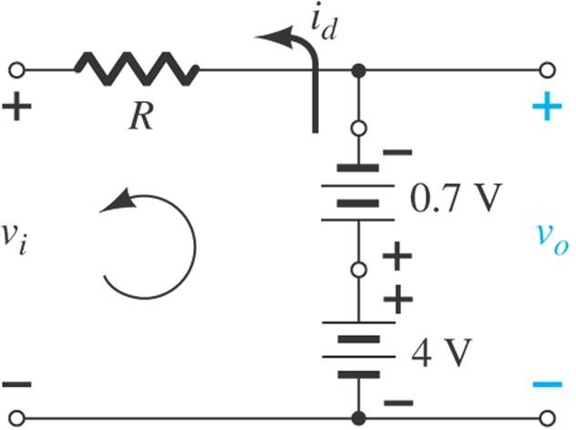
Example:
Determine v_{o} for the network if Si diode is used.
Solution
Determining v_{o} for the diode in the “on” state.

Slide 33
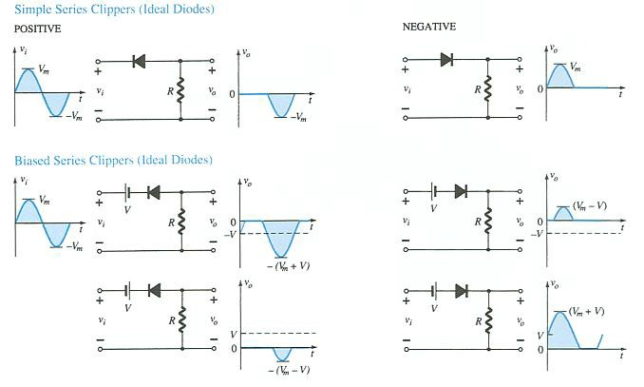


Examples:

Slide 34
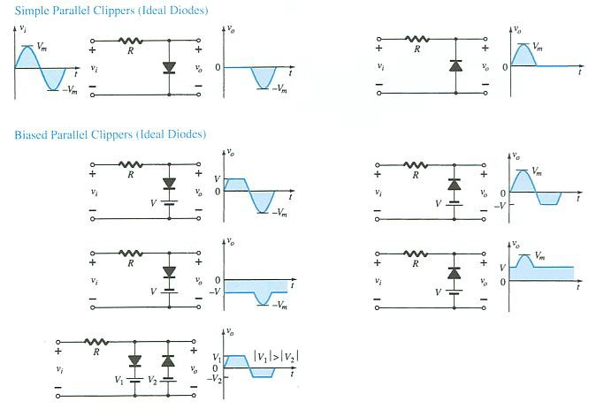

Examples:

Slide 35
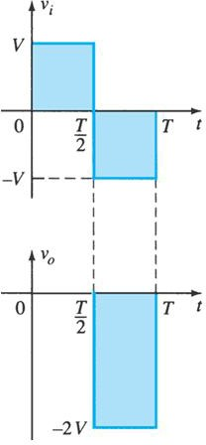
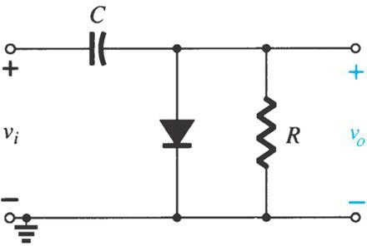
CLAMPERS
A clamper is a network constructed of a diode, a resistor, and a capacitor that shifts a waveform to a different DC level.

Slide 36
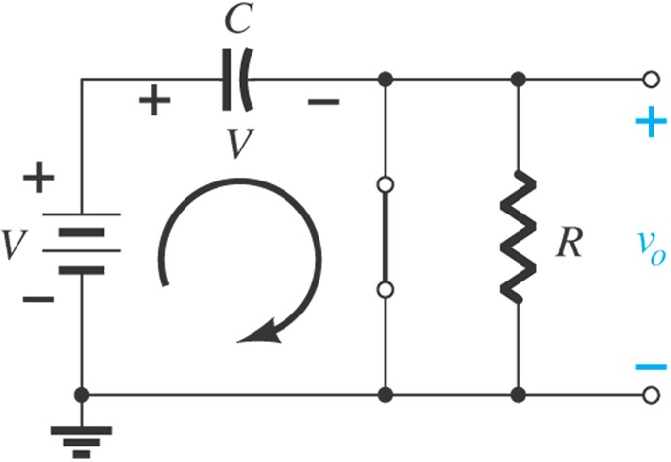
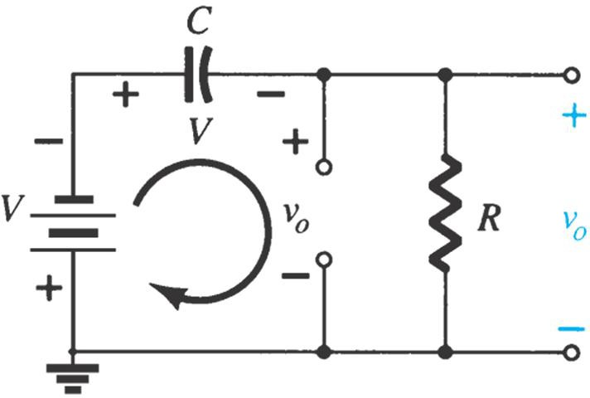
CLAMPERS
R is chosen such that the discharge period 5τ=5RC is much larger than the period T/2→T, and the capacitor is assumed to hold onto all its charge.
Diode “on” and the capacitor charging to V volts.
Determining v_{o} with the diode “off.”

Slide 37
CLAMPERS

Slide 38
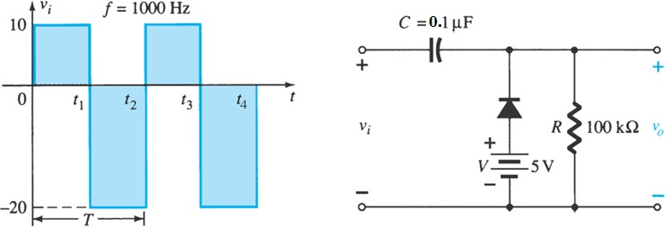
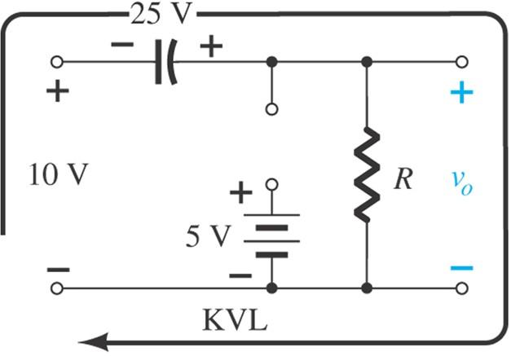
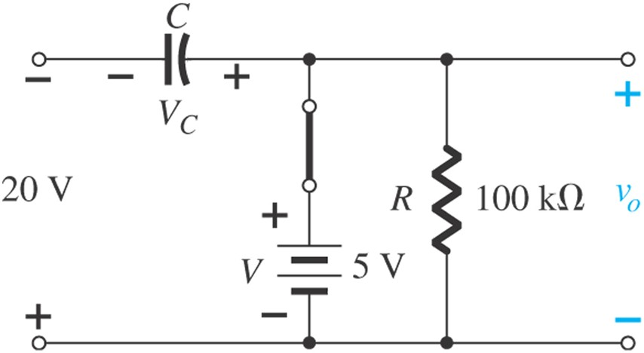
Example
Determine v_{o} for the network.
Solution
Determining v_{o} and V_{C} with the diode in the “on” state.
Determining v_{o} with the diode in the “off” state.

Slide 39
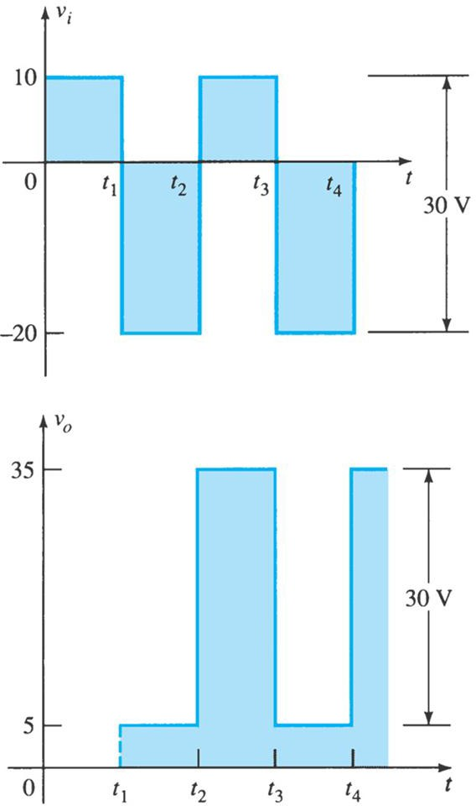
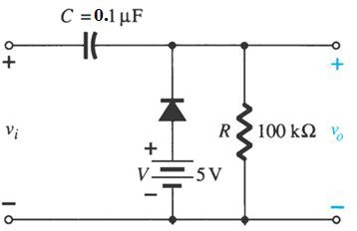
Example

Slide 40
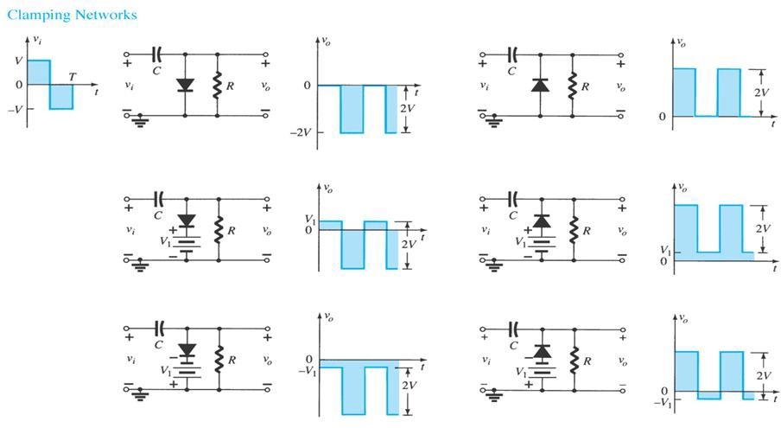
Clipper circuits
Clamping circuits with ideal diodes (5τ = 5RC >> T/2).

Slide 41
Thanks
#Keep Learning#

